Slide 1
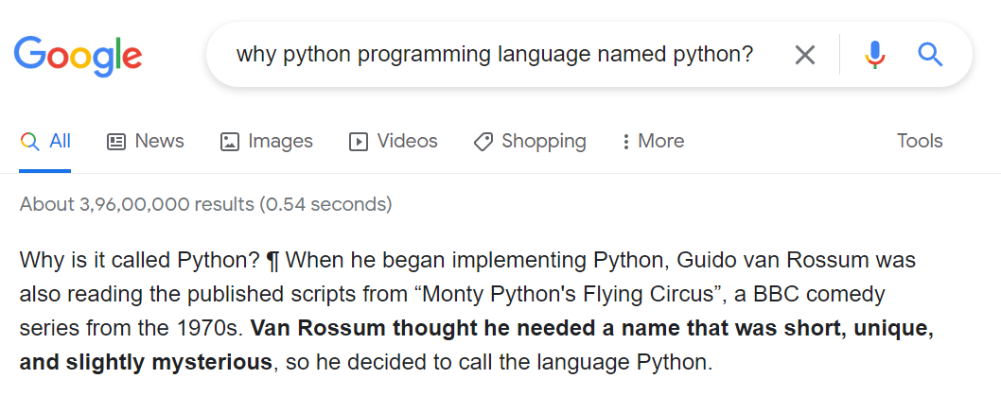
PYTHON PROGRAMMING

Slide 2
Python
Python is a general-purpose language.
Python is a Scripting Language
Scripting language are written using high level language constructs, which makes them easy to learn.
It has wide range of applications from Web development, scientific and mathematical computing to desktop graphical user Interfaces.
The syntax of the language is clean and length of the code is relatively short.
It's easy to work in Python because it allows you to think about the problem rather than focusing on the syntax.

Slide 3
Python Programming Cycle
Relatively shorter than other language.
There is no compile or link step while it is in built step.
Python interpreter internally does the compilation
Python program simply imports library at run time and uses the objects.

Slide 4
Traditional programming cycle vs Programming cycle for python
 | Python programming cycle | Traditional programming cycle
STEP #1 | RUN THE APPLICATION | RUN THE APPLICATION
STEP #2 | TEST THE APPLICATION | TEST THE APPLICATION
STEP #3 | EDIT SOURCE CODE AGAIN | EDIT SOURCE CODE AGAIN
STEP #4 | SKIP THIS STEP | RECOMPILE
STEP #5 | SKIP THIS STEP | RE-LINK
STEP #6 | REPEAT (IF NEEDED) | REPEAT (IF NEEDED)

Slide 5
Properties of Python
Python is Interpreted − Python is processed at runtime by the interpreter. You do not need to compile your program before executing it. This is similar to PERL and PHP.
Python is Interactive − You can actually sit at a Python prompt and interact with the interpreter directly to write your programs.
Python is Object-Oriented − Python supports Object-Oriented style or technique of programming that encapsulates code within objects.
Python is a Beginner's Language − Python is a great language for the beginner-level programmers and supports the development of a wide range of applications from simple text processing to WWW browsers to games

Slide 6
Features of python..
Simplicity: Think less of the syntax of the language and more of the code.
Open Source: A powerful language and it is free for everyone to use and alter as needed.
Portability: Python code can be shared and it would work the same way it was intended to. Seamless and hassle-free.
Being Embeddable & Extensible: Python can have snippets of other languages inside it to perform certain functions.
Being Interpreted: The worries of large memory tasks and other heavy CPU tasks are taken care of by Python itself leaving you to worry only about coding.
Huge amount of libraries: Python can be used in many more areas, such as data science, ML, web development, network programming, and software prototyping.
Object Orientation: Objects help breaking-down complex real-life problems into such that they can be coded and solved to obtain solutions.

Slide 7
History of Python
Python was developed by Guido van Rossum in 1991 at the National Research Institute for Mathematics and Computer Science in the Netherlands.
Python is derived from many other languages, including ABC, Modula-3, C, C++, Algol-68, SmallTalk, and Unix shell and other scripting languages.

Slide 8
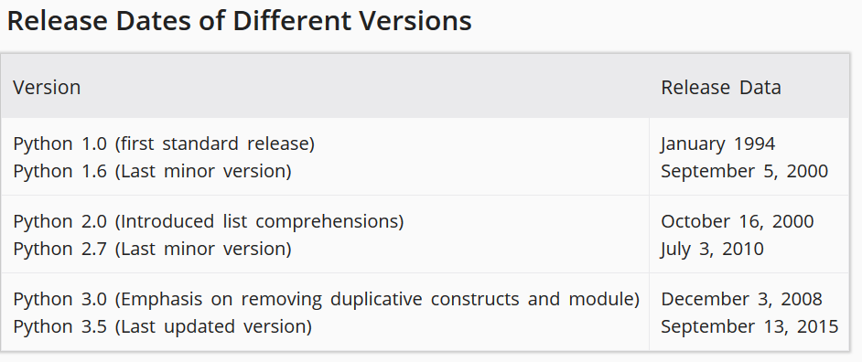
Python Versions Being open source various versions exists Latest is 3.10.4 (April,2022)

Slide 9
Python 2 vs python 3
Python 2 | Python 3
>>7 / 5 Results: 1 | >>7/5 Results: 1.4
print “message” | print (“Message”)
Xrange | Range
Exception alias mentioned with , except NameError, err: | Alias mentioned with ‘as’ except NameError as err:
In order to suppress a newline while printing, you had to use a trailing comma in Python 2. print 2, print 4 2 4 | in Python 3, you have to use the end keyword argument. print(2, end =" ") print(4) 2 4
In Python 2, both != and <> used to work perfectly fine as inequality operators. | in python 3, the alternative of <> has been completely removed. Basically now there is only one way of doing it. By using the != operator.
raw_input(), input both supported, The difference was that, input() was able to read and store any data type and store it as the same type. In order to store every input as a string, you had to use raw_input() | Python 3, the raw input() has been removed. There is only the input() method and it parses the user input as string for every data type.

Slide 10
Getting Python
The most up-to-date and current source code, binaries, documentation, news, etc., is available on the official website of Python https://www.python.org/
You can download Python documentation from https://www.python.org/doc/. The documentation is available in HTML, PDF, and PostScript formats.

Slide 11
IDEs
Pycharm
Jupyter Notebook
Enthought Canopy
IDLE
Spyder
….

Slide 12
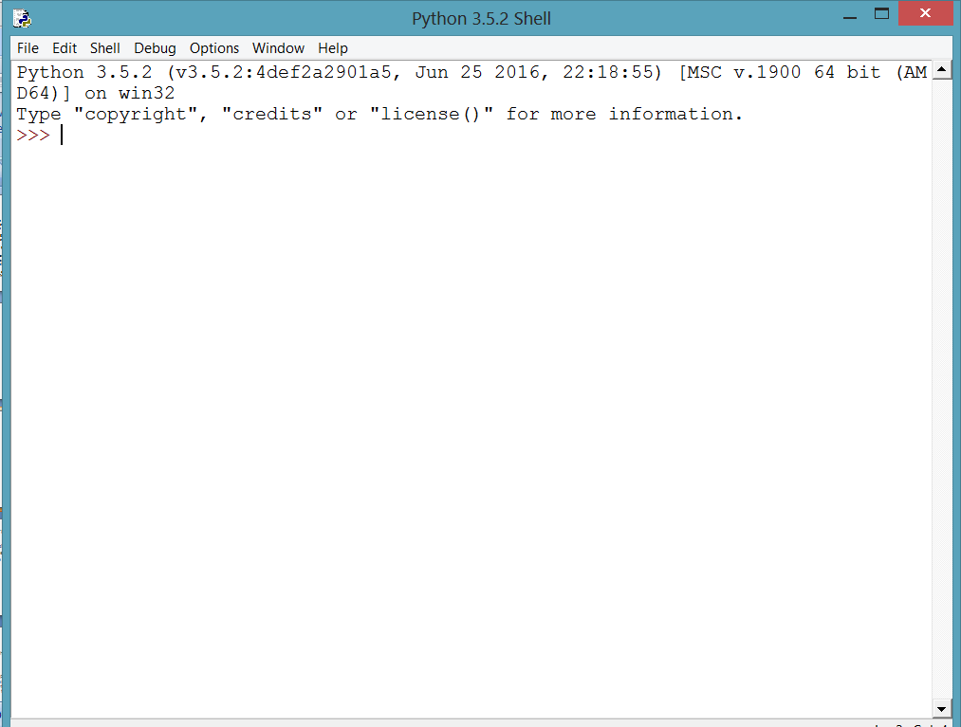
IDLE

Slide 13
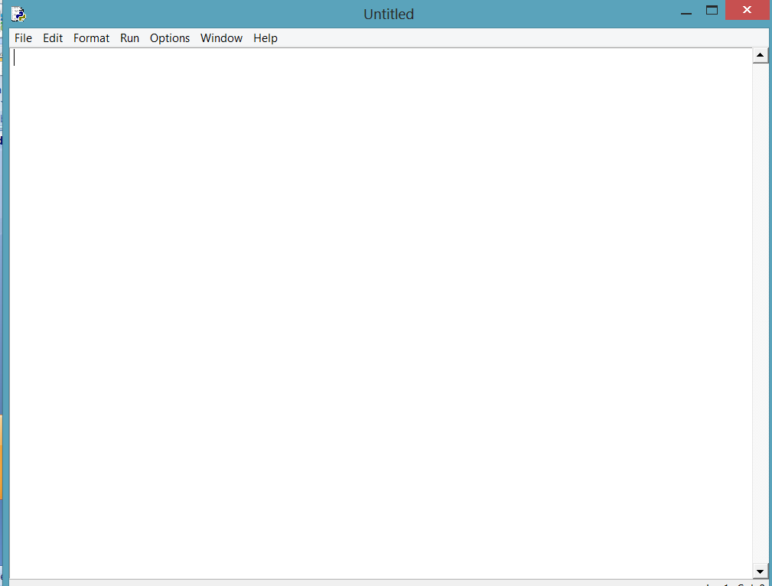
IDLE Script Writer(From File select New)

Slide 14
First Python Program
The Python language has many similarities to Perl, C, and Java. However, there are some definite differences between the languages.
# Add two numbers
num1 = 3
num2 = 5
sum = num1+num2
print(sum)

Slide 15
Type the following text at the Python prompt and press the Enter −
>>> print ("Hello, Python!" )
this produces
the following result −
Hello, Python!

Slide 16
Python Identifiers
A Python identifier is a name used to identify a variable, function, class, module or other object. An identifier starts with a letter A to Z or a to z or an underscore (_) followed by zero or more letters, underscores and digits (0 to 9).
Python does not allow punctuation characters such as @, $, and % within identifiers.
Python is a case sensitive programming language.
Here are naming conventions for Python identifiers −

Slide 17
Reserved Words
Reserved Words
The following list shows the Python keywords. These are reserved words and you cannot use them as constant or variable or any other identifier names. All the Python keywords contain lowercase letters only.
and
not
assert
Finally
or, break ,for, pass, class, from ,print, continue, global, raise, def, if, return, del, import, try, elif, in, while, else,is, with, except, lambda, yield ,None

Slide 18
Lines and Indentation
Python provides no braces to indicate blocks of code for class and function definitions or flow control. Blocks of code are denoted by line indentation, which is rigidly enforced.
The number of spaces in the indentation is variable, but all statements within the block must be indented the same amount

Slide 19
Quotation in Python
Python accepts single ('), double (") and triple (''' or """) quotes to denote string literals, as long as the same type of quote starts and ends the string.
The triple quotes are used to span the string across multiple lines. For example, all the following are legal −
word = 'word' sentence = "This is a sentence." paragraph = """This is a paragraph. It is made up of multiple lines and sentences."""

Slide 20
Comments in Python
A hash sign (#) that is not inside a string literal begins a comment. All characters after the # and up to the end of the physical line are part of the comment and the Python interpreter ignores them.

Slide 21
Multi-Line Statements
Statements in Python typically end with a new line. Python does, however, allow the use of the line continuation character (\) to denote that the line should continue. For example −
total = item_one + \ item_two + \ item_three
Statements contained within the [], {}, or () brackets do not need to use the line continuation character. For example −
days = ['Monday', 'Tuesday', 'Wednesday', 'Thursday', 'Friday']

Slide 22
Variables
Variables are nothing but reserved memory locations to store values. This means that when you create a variable you reserve some space in memory.
Based on the data type of a variable, the interpreter allocates memory and decides what can be stored in the reserved memory. Therefore, by assigning different data types to variables, you can store integers, decimals or characters in these variables.

Slide 23
Assigning Values to Variables
Python variables do not need explicit declaration to reserve memory space. The declaration happens automatically when you assign a value to a variable. The equal sign (=) is used to assign values to variables.
The operand to the left of the = operator is the name of the variable and the operand to the right of the = operator is the value stored in the variable. For example −
#!/usr/bin/python counter = 100 # An integer assignment
miles = 1000.0
# A floating point
name = "John" # A string
print (counter )
print (miles)
print (name)

Slide 24
Multiple Assignment
Python allows you to assign a single value to several variables simultaneously. For example −
a = b = c = 1 Here, an integer object is created with the value 1, and all three variables are assigned to the same memory location.
You can also assign multiple objects to multiple variables. For example −
a,b,c = 1,2,"john" Here, two integer objects with values 1 and 2 are assigned to variables a and b respectively, and one string object with the value "john" is assigned to the variable c.

Slide 25
Standard Data Types
The data stored in memory can be of many types. For example, a person's age is stored as a numeric value and his or her address is stored as alphanumeric characters. Python has various standard data types that are used to define the operations possible on them and the storage method for each of them.
Python has five standard data types −
Numbers
String
List
Tuple
Dictionary

Slide 26
Python Numbers
Number data types store numeric values. Number objects are created when you assign a value to them. For example −
var1 = 1 var2 = 10 You can also delete the reference to a number object by using the del statement. The syntax of the del statement is −
del var1 You can delete a single object or multiple objects by using the del statement with variable separated by coma.
For example −
del var1, var2
Python supports following different numerical types −
int
float
complex

Slide 27
Examples Here are some examples of numeric types
int | float | complex
10 | 0.0 | 3.14j
100 | 15.20 | 45.j
-786 | -21.9 | 9.322e-36j
080 | 32.3+e18 | .876j
-0490 | -90. | -.6545+0J
-0x260 | -32.54e100 | 3e+26J

Slide 28
Python Objects
Everything in python is object.
Every object specifically data has three properties type, id and value
ID remains same once data is created.
Objects whose value can change after creation is called mutable and whose value can't be changed is called immutable
Mutable examples: list, set, dictionary
Immutable examples: int, float, decimal, bool, string, tuple, and range.

Slide 29
Python - Basic Operators Operators are the constructs which can manipulate the value of operands. Consider the expression 4 + 5 = 9. Here, 4 and 5 are called operands and + is called operator.
Types of Operator
Python language supports the following types of operators.
Arithmetic Operators
Comparison (Relational) Operators
Assignment Operators
Logical Operators
Bitwise Operators
Membership Operators
Identity Operators

Slide 30
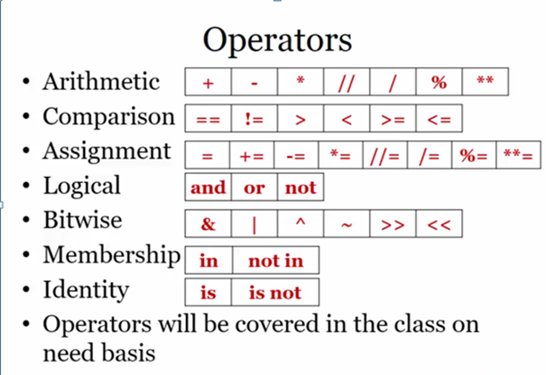

Slide 31
Operator | Description | Example
+ Addition | Adds values on either side of the operator. | a + b = 30
- Subtraction | Subtracts right hand operand from left hand operand. | a – b = -10
* Multiplication | Multiplies values on either side of the operator | a * b = 200
/ Division | Divides left hand operand by right hand operand | b / a = 2
% Modulus | Divides left hand operand by right hand operand and returns remainder | b % a = 0
** Exponent | Performs exponential (power) calculation on operators | a**b =10 to the power 20
// | Floor Division - The division of operands where the result is the quotient in which the digits after the decimal point are removed. But if one of the operands is negative, the result is floored, i.e., rounded away from zero (towards negative infinity) − | 9//2 = 4 and 9.0//2.0 = 4.0, -11//3 = -4, -11.0//3 = -4.0

Slide 32
Python Comparison Operators These operators compare the values on either sides of them and decide the relation among them. They are also called Relational operators. Assume variable a =10 and variable b=20, then −
Operator | Description | Example
== | If the values of two operands are equal, then the condition becomes true. | (a == b) is not true.
!= | If values of two operands are not equal, then condition becomes true. | (a != b) is true.
> | If the value of left operand is greater than the value of right operand, then condition becomes true. | (a > b) is not true.
< | If the value of left operand is less than the value of right operand, then condition becomes true. | (a < b) is true.
>= | If the value of left operand is greater than or equal to the value of right operand, then condition becomes true. | (a >= b) is not true.
<= | If the value of left operand is less than or equal to the value of right operand, then condition becomes true. | (a <= b) is true.

Slide 33
Python Assignment Operators
Operator | Description | Example
= | Assigns values from right side operands to left side operand | c = a + b assigns value of a + b into c
+= Add AND | It adds right operand to the left operand and assign the result to left operand | c += a is equivalent to c = c + a
-= Subtract AND | It subtracts right operand from the left operand and assign the result to left operand | c -= a is equivalent to c = c - a
*= Multiply AND | It multiplies right operand with the left operand and assign the result to left operand | c *= a is equivalent to c = c * a
/= Divide AND | It divides left operand with the right operand and assign the result to left operand | c /= a is equivalent to c = c / ac /= a is equivalent to c = c / a
%= Modulus AND | It takes modulus using two operands and assign the result to left operand | c %= a is equivalent to c = c % a
**= Exponent AND | Performs exponential (power) calculation on operators and assign value to the left operand | c **= a is equivalent to c = c ** a
//= Floor Division | It performs floor division on operators and assign value to the left operand | c //= a is equivalent to c = c // a

Slide 34
Python Bitwise Operators
Bitwise operator works on bits and performs bit by bit operation. Assume if a = 60; and b = 13; Now in binary format they will be as follows −
a = 0011 1100
b = 0000 1101
-----------------
a&b = 0000 1100
a|b = 0011 1101
a^b = 0011 0001
~a = 1100 0011
There are following Bitwise operators supported by Python language.

Slide 35
Python Logical Operators:
Operator | Description | Example
and | Called Logical AND operator. If both the operands are true then then condition becomes true. | (a and b) is true.
or | Called Logical OR Operator. If any of the two operands are non zero then then condition becomes true. | (a or b) is true.
not | Called Logical NOT Operator. Use to reverses the logical state of its operand. If a condition is true then Logical NOT operator will make false. | not(a and b) is false.

Slide 36
Operator | Description | Example
& Binary AND | Operator copies a bit to the result if it exists in both operands | (a & b) (means 0000 1100)
| Binary OR | It copies a bit if it exists in either operand. | (a | b) = 61 (means 0011 1101)
^ Binary XOR | It copies the bit if it is set in one operand but not both. | (a ^ b) = 49 (means 0011 0001)
~ Binary Ones Complement | It is unary and has the effect of 'flipping' bits. | (~a ) = -61 (means 1100 0011 in 2's complement form due to a signed binary number.
<< Binary Left Shift | The left operands value is moved left by the number of bits specified by the right operand. | a << 2 = 240 (means 1111 0000)
>> Binary Right Shift | The left operands value is moved right by the number of bits specified by the right operand. | a >> 2 = 15 (means 0000 1111)

Slide 37
Python Membership Operators Python’s membership operators test for membership in a sequence, such as strings, lists, or tuples. There are two membership operators as explained below −
Operator | Description | Example
in | Evaluates to true if it finds a variable in the specified sequence and false otherwise. | x in y, here in results in a 1 if x is a member of sequence y.
not in | Evaluates to true if it does not finds a variable in the specified sequence and false otherwise. | x not in y, here not in results in a 1 if x is not a member of sequence y.

Slide 38
Overall operators' precedence
Operator | Description
() | Highest
** | Exponentiation (raise to the power)(right to left)
~ + - | Ccomplement, unary plus and minus (method names for the last two are +@ and -@)
* / % // | Multiply, divide, modulo and floor division
+ - | Addition and subtraction
>> << | Right and left bitwise shift
& | Bitwise 'AND'
^ | | Bitwise exclusive `OR' and regular `OR'
<= < > >= | Comparison operators (x<y<z will be interpreted as x<y and y <z and then left to right)
== != | Equality operators
= %= /= //= -= += *= **= | Assignment operators(Right to left)
is is not | Identity operators
in not in | Membership operators
not or and | Logical operators

Slide 39
Overall operators' precedence
Operators | Meaning
() | Parentheses
** | Exponent
+x, -x, ~x | Unary plus, Unary minus, Bitwise NOT
*, /, //, % | Multiplication, Division, Floor division, Modulus
+, - | Addition, Subtraction
<<, >> | Bitwise shift operators
& | Bitwise AND
^ | Bitwise XOR
| | Bitwise OR
==, !=, >, >=, <, <=, is, is not, in, not in | Comparisons, Identity, Membership operators
not | Logical NOT
and | Logical AND
or | Logical OR
= %= /= //= -= += *= **= | Assignment expression

Slide 40
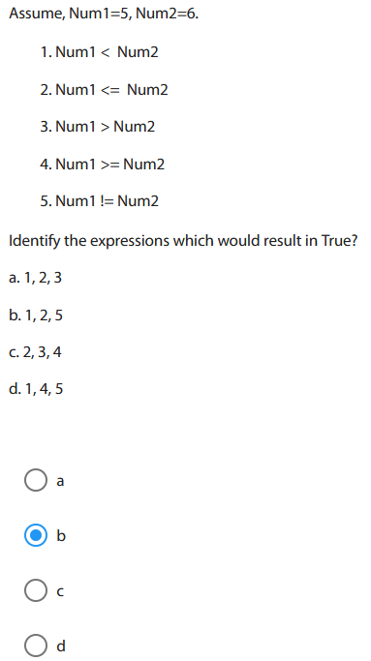

Slide 41
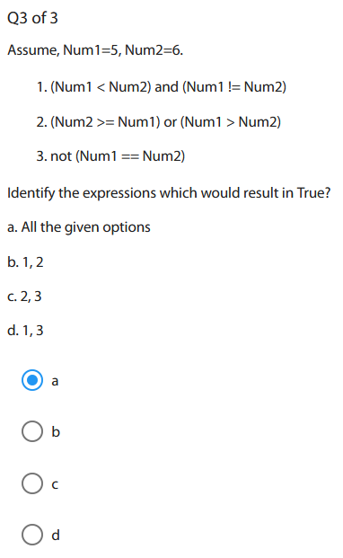

Slide 42
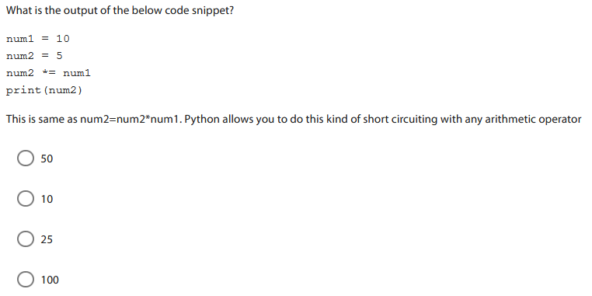
bac

Slide 43
Using Input() Functions
Reads data from user
Parameter is optional string message/ expression
Returns the data input as string representation

Slide 44
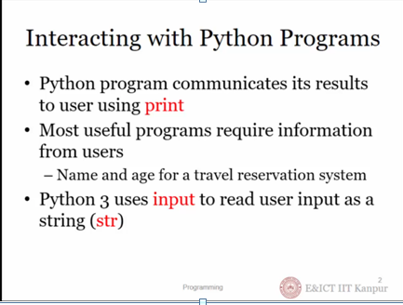

Slide 45
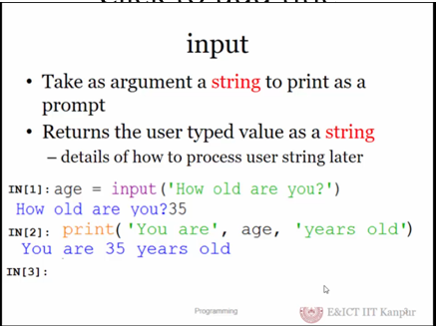

Slide 46
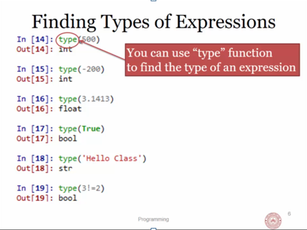

Slide 47
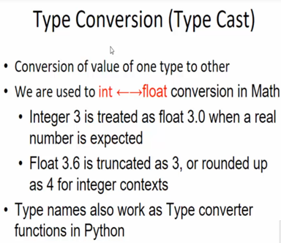

Slide 48
Type conversion Functions
int() – converts any data type into integer type
float() – converts any data type into float type
str() – Converts any var. value/Constant into string type
ord() – converts characters into integer
hex() – converts integers to hexadecimal
oct() – converts integer to octal
Many other will see in future

Slide 49
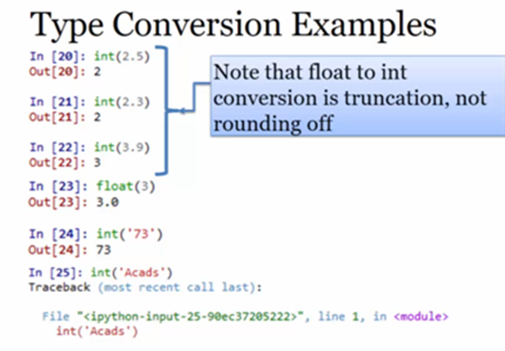

Slide 50
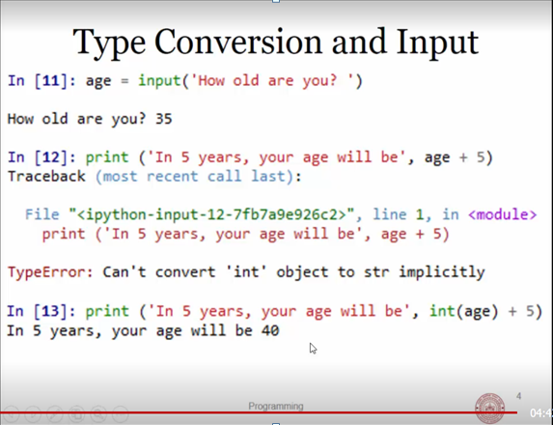

Slide 51
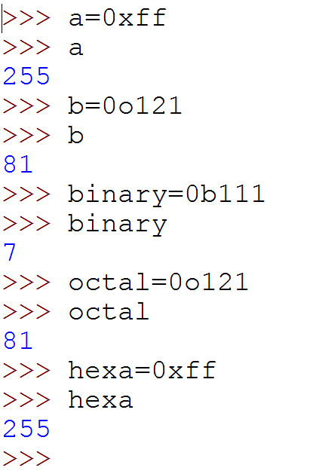
Reading binary octal and hex number

Slide 52
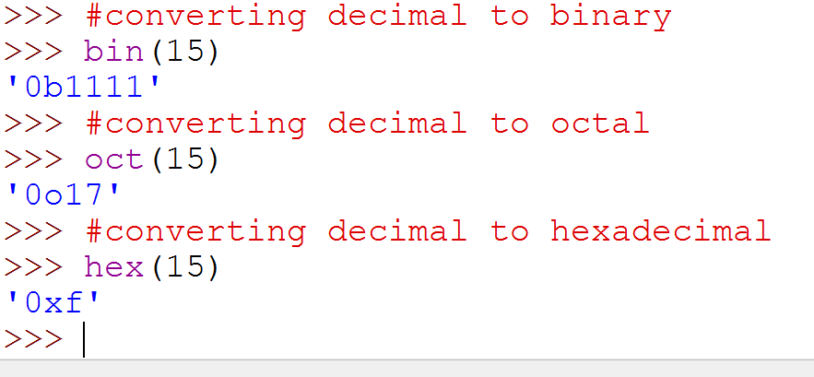
Converting Decimal to non decimal Can also use non decimal as input

Slide 53
Write a python program to find area of rectangle when input to be taken from user.
Think about these questions
How many variables required
How to take input
How to calculate result
How to display output.

